Slide 1
WGST 100-991: Introduction to Women’s and Gender Studies
Week 5: Wednesday, Oct. 3/18
Construction of Sex and Gender: Feminism and the Waves Part I

Slide 2

Recap-Feminist Theory

Slide 3
Recap-Feminist Theory
Subset of Critical Theory
Patriarchy: the hierarchical organization of society, with males dominating most of the positions of power and wealth, while a disproportionate number of females fill subordinate positions with little wealth or control.

Slide 4
Recap: Strands of Feminism
Liberal Feminism: equality of opportunity
Socialist Feminism: economic systems
Radical Feminism: power and oppression
Cultural Feminism: celebrating difference

Slide 5
The Quick and Dirty Social History of Gender Relations
A Brief history of gender relations in Canada:
Pre-Industrial-before 1800’s
Industrial-1800’s to 1950
Post-Industrial-1950 to present

Slide 6
Waves of Feminism
First Wave: women’s movement of the late 19th and early 20th centuries that focused on the women’s right to vote, own property, and participate in public life.
Traditionally men dominated both the public and private sphere’s of society.
They have dominated the vast majority of public offices and power positions in almost all social institutions.

Slide 7
First Wave in Canada
Based around the idea of “maternal feminism” (the idea that women are natural caregivers and “mothers of the nation” who should participate in public life because of their perceived propensity for decisions that will result in good care of society).
As such, women were seen to be a benevolent and civilizing force in society.
Religion played a prominent role in early organization and many women’s groups were extensions of church groups.

Slide 8
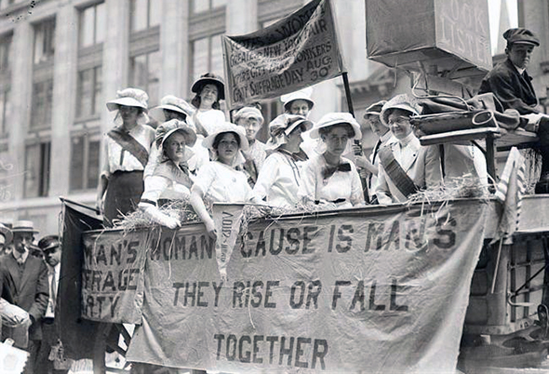
First Wave in Canada

Slide 9
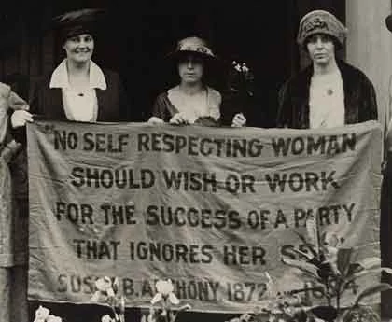
First Wave in Canada

Slide 10
First Wave in Canada: The Right to Vote
Also called the suffrage movement.
Based on the idea that political power resting solely on men has been somewhat of a social disaster.
Example: World War One.
Widows and unmarried women get the right to vote in municipal elections in Ontario-1884
Saskatchewan in 1916
Military Voters Act 1917
Full franchise 1919

Slide 11
First Wave in Canada: Women as “Persons”
The fight to be regarded as “persons” under the law
BNA Act 1867 sec. 24
1928 Canadian Supreme Court says no
1929 Judicial Committee of the Privy Council says yes, calling any ruling otherwise “a barbaric practice from a bygone age.”
https://www.youtube.com/watch?v=if_pyx5dm9Y

Slide 12
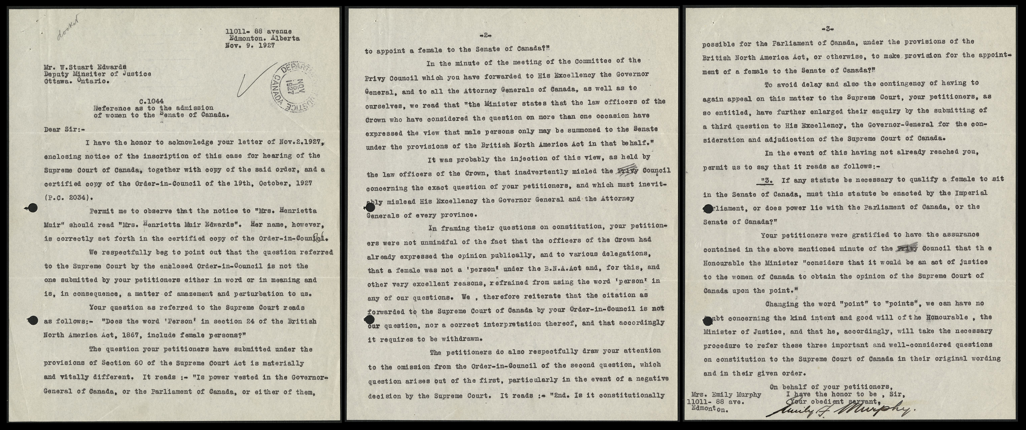
First Wave in Canada: Women as “Persons”

Slide 13
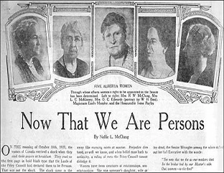
First Wave in Canada: Women as “Persons”

Slide 14
First Wave in Canada: Critique
What are some weaknesses or critiques of this first wave?

Slide 15
Second Wave of Feminism
Emerged in the 1960’s.
Focused on:
1. equal opportunities
2. reproductive freedoms
3. solutions to violence

Slide 16
Second Wave of Feminism
All about an attempt to renegotiate the space between the public and the private.
Some aspects of private life should be beyond political and legal action.
Separate but equal spaces.

Slide 17
Second Wave of Feminism: Equal Opportunity
Women are now in the workforce in significant numbers.
But disparity in both job opportunity and pay are apparent.
Royal Commission on the Status of Women, 1970.
Commissioned by P.M. Pearson in 1967 with the mandate to view the inequality between men and women in Canadian society.
Comprised 5 women and 2 men, chaired by Florence Bird.

Slide 18
Second Wave of Feminism: Royal Commission on the Status of Women
Some facts reviewed by the Commission:
in 1970 only 3.9% of managers were women.
although 8 out of 10 provinces had equal-pay laws, women were still paid less than men for doing the same work.
two thirds of people that were on welfare were women.

Slide 19
Second Wave of Feminism: Royal Commission on the Status of Women
Recommendations:
"gender" and "marital status" be prohibited as grounds for discrimination by employers
training programs offered by the federal government be made more open to women
the federal government name more women judges to all courts within its jurisdiction
more qualified women from each province be appointed to the Senate as seats became vacant, until a more equitable balance between men and women were achieved
employed women be granted eighteen weeks of unemployment benefits for maternity leave.
Birth control
Pensions
Day care
Educational opportunities for women

Slide 20
Second Wave of Feminism
National Action Committee on the Status of Women
Formed in 1972 as a coalition of 23 different women’s groups as a response to perceived federal inaction of the Royal Commission recommendations.
Becomes the “unofficial” voice of women in Canada.
Budget cutbacks in the 1980’s have now reduced their influence.

